Slide 2
Module 7: Advanced SQL Day 2

Slide 3
Agenda 28.10.2022
from | to | topic
9:00 | 9:15 | Introduction
9:15 | 12:30 | Self Study Block
~10:30 | ~10:45 | Coffee break
12:00 | 12:30 | Discussion Block: Self Study Session
12:30 | ~13:00 | Lunch Break
13:00 | 13:30 | Content Questions
13:30 | 16:00 | Excecise Block
16:00 | 17:00 | Discussion Block : Excercise

Slide 4

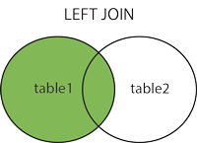
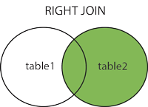
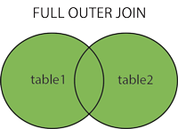
Topics for today in Breif
Joins
Used to join the rows and columns of 2 or more tables, based on a related column between them.

Slide 5
Material
Watch the videos 29-32, 54 of the below playlist:
https://www.youtube.com/playlist?list=PL_RGaFnxSHWr_6xTfF2FrIw-NAOo3iWMy
Also watch the below video:
https://www.youtube.com/watch?v=vncBSUNb4NA
Go through the below training material- `SQL Joins` - `SQL Unions`:
https://www.w3schools.com/sql/sql_join.asp

Slide 6
Questions
Answer the below questions:
List the ways to get the count of records in a table?
What is the need for group functions/aggregate functions in SQL?
How can you fetch first 5 characters of the string?
What is self join and cross join?
What is the difference between Union and Union All operators?
What is the SQL query to display the current date?
What are the different types of a subquery?
What is the difference between Nested Subquery and Correlated Subquery?

Slide 7
Exercise
Write a query to find the name (first_name, last name), department ID and name of all the employees.
Write a query to find the name (first_name, last_name), job, department ID and name of the employees who works in London.
Write a query to find the employee id, name (last_name) along with their manager_id and name (last_name).
Write a query to find the name (first_name, last_name) and hire date of the employees who was hired after 'Jones'.
Write a query to get the department name and number of employees in the department
Write a query to find the employee ID, job title, number of days between ending date and starting date for all jobs in department 90.
Write a query to display the department ID and name and first name of manager.

Slide 8
Exercise
Write a query to display the department name, manager name, and city.
Write a query to display the job title and average salary of employees.
Write a query to display job title, employee name, and the difference between salary of the employee and minimum salary for the job.
Write a query to display the job history that were done by any employee who is currently drawing more than 10000 of salary.
Write a query to display department name, name (first_name, last_name), hire date, salary of the manager for all managers whose experience is more than 15 years.

Slide 9
Good luck!
Dein yakha Team

